Slide 1

Project
on
“Earthquake Prediction Using Machine Learning”
Presented By:
Kanishka Pareek, 20EJCAD029
Aryank Gupta, 20EJCAD012
Muskan Tambi, 20EJCAD046
Sujal Jain, 20EJCAD064
8TH SEM AI&DS
Submitted To:
Ms.Punita Pawar
Assistant Professor
AI&DS Department

Slide 2
Contents
Problem Statement
Objective
Approach
Project Description
Implementation
Tools/Technologies Required
Conclusion
References

Slide 3
Problem Statement
Awareness and Preparedness Towards Disaster Management
Mock exercises, School Safety Programs (SSP), and Community Awareness Programs (CAP) conducted by disaster management authorities aim to enhance community preparedness for earthquakes, leveraging earthquake prediction datasets. Through simulations and drills, these exercises identify response gaps and improve readiness. Timely notification and participation ensure communities are prepared for future seismic events, with access to resources and information provided by Disaster Management Authorities.

Slide 4
Objective
By conducting community awareness programs (CAP), school safety programs (SSP), and mock exercises, stakeholders like NDRF/SDRF may further the goal of improving community preparedness and response skills for disasters. Through simulating actual situations, identifying response gaps, and enhancing preparedness, these projects hope to ensure prompt registration and participation for efficient disaster management.

Slide 5
Approach
In our approach, we utilize earthquake datasets to construct machine learning models, including Linear Regression, Ridge Regression, Lasso Regression, Random Forest Regressor, Gradient Boosting Regressor, Support Vector Regressor (SVR), and K-Nearest Neighbors Regressor. By employing these diverse algorithms, we aim to predict earthquake occurrences with enhanced accuracy, facilitating more effective disaster preparedness and response measures.

Slide 6
Project Description
This project aims to develop a robust earthquake prediction model utilizing machine learning algorithms. Earthquakes pose significant risks to communities worldwide, and accurate predictions can help mitigate their impact.
The implementation involves several key steps.
Firstly, we'll gather a comprehensive dataset comprising historical earthquake data, including seismic activity, geographical features, and relevant environmental factors.

Slide 7
This data will be preprocessed to remove noise and outliers, ensuring the quality of input features.
Next, we'll employ various machine learning techniques such as regression, classification, and clustering to build predictive models. These models will analyze patterns in the data to forecast the likelihood and intensity of future earthquakes.
Feature engineering will play a crucial role in extracting relevant information and enhancing the predictive power of the models.

Slide 8
Additionally, we'll implement model evaluation techniques such as cross-validation and performance metrics like accuracy, precision, and recall to assess the efficacy of our predictions. Iterative refinement of the models will be conducted to enhance their accuracy and reliability.
Finally, we'll deploy the earthquake prediction model in a user-friendly interface, enabling stakeholders to access real-time earthquake forecasts and take proactive measures to minimize risks and ensure public safety.

Slide 9
Implementation
Certainly! Here's a comprehensive breakdown of each step involved in building an earthquake prediction model using machine learning:
Data Cleaning:
Handling Missing Values: Identify and handle missing data appropriately, whether through imputation techniques or removing incomplete records.
Outlier Detection: Identify and deal with outliers that might skew the distribution of the data.
Data Normalization: Normalize the data to ensure that features are on a similar scale, which can aid in model convergence and performance.

Slide 10
Data Visualization:
Seismic Data Exploration: Visualize seismic data using techniques such as time series plots, spectrograms, and heatmaps to understand patterns and trends.
Geospatial Visualization: Plot seismic events on a map to visualize their geographical distribution and identify regions of high seismic activity.
Feature Correlation Analysis: Visualize correlations between different features to understand their relationships and identify potentially important predictors.

Slide 11
Feature Selection:
Correlation Analysis: Identify features that are highly correlated with earthquake occurrence and remove redundant features to improve model efficiency.
Feature Importance: Use techniques like Random Forest feature importance or Recursive Feature Elimination to select the most relevant features for predicting earthquakes.
Domain Knowledge Integration: Incorporate domain knowledge from seismology to guide feature selection and prioritize relevant seismic attributes.

Slide 12
Model Training:
Model Selection: Experiment with various machine learning algorithms suitable for classification tasks, such as decision trees, random forests, support vector machines (SVM), or deep learning models.
Hyperparameter Tuning: Optimize model hyperparameters using techniques like grid search or random search to improve model performance.
Cross-Validation: Validate the model using techniques like k-fold cross-validation to ensure its generalization to unseen data.

Slide 13
Model Analysis and Accuracy:
Evaluation Metrics: Measure model performance using appropriate evaluation metrics such as accuracy, precision, recall, F1-score, and area under the ROC curve (AUC-ROC).
Interpretability: Interpret the model's predictions and assess its reliability and robustness in real-world earthquake prediction scenarios.
Model Validation: Validate the model's accuracy using independent datasets or real-time monitoring to ensure its effectiveness in practical applications.

Slide 14
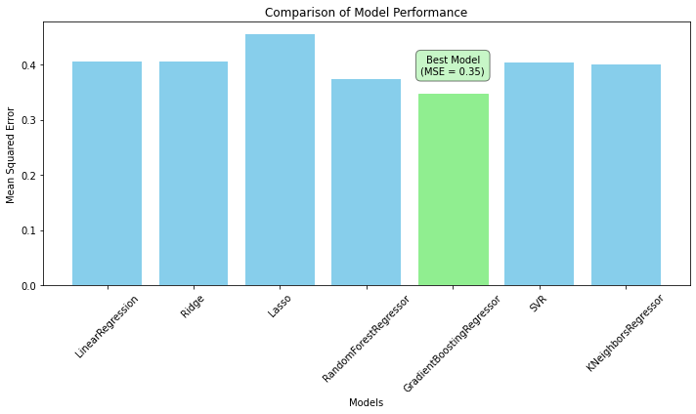
Screenshots:

Slide 15
Tools/Technologies Required
System requirements:
*Hardware:* - High-performance computing infrastructure (CPU, RAM).
*Software:* - Programming languages: Python. - libraries : Numpy, Pandas, matplotlib, Seaborn, and Machine learning libraries: scikit-learn, TensorFlow, PyTorch, Database management systems, Source code editor: Vs code
Model *Expertise:* - Machine learning, statistical analysis, and geoscience. - Model development and validation techniques.

Slide 16
Tools/Technologies Required
* Data Sources:* - National Center for Seismology Ministry of Earth Sciences Government of India - Geological and environmental datasets.
*Collaboration Tools:* - Platforms for team collaboration and communication. By meeting these requirements, you can effectively develop and deploy an earthquake prediction
Project management and coordination tools: Notion, Jira, Slack, Github.

Slide 17
Conclusion
In conclusion, the development of an earthquake prediction model using machine learning represents a promising approach to mitigating seismic risks. While challenges such as data quality and model complexity persist, the potential benefits of early detection and warning systems are substantial. By leveraging advanced techniques in data cleaning, feature selection, and model training, we aim to enhance our understanding of seismic patterns and improve prediction accuracy. Thus enhancing ability to forecast earthquakes, mitigate risks, and ultimately save lives in earthquake-prone regions around the world.

Slide 18
References
Research Papers:
"Earthquake Prediction: A Machine Learning Approach" by H. Tamura et al. and "Machine Learning Techniques Applied to Earthquake Magnitude Prediction" by A. H. Madadzadeh et al.
Books:
"Machine Learning: A Probabilistic Perspective" by Kevin P. Murphy, and "Introduction to Seismology" by Peter M. Sheare
Online Resources:
https://www.coursera.org/
https://www.geeksforgeeks.org/
https://www.quora.com/
www.stackoverflow.com/
https://www.sih.gov.in/

Slide 19
Thank You

